Slide 1
WAP & WML

Slide 2
Introducing WAP
Stands for Wireless Application Protocol
WAP is an application communication protocol
WAP is used to access services and information
WAP is for handheld devices such as mobile phones
WAP is a protocol designed for micro browsers
WAP enables the creating of web applications for mobile devices.

Slide 3
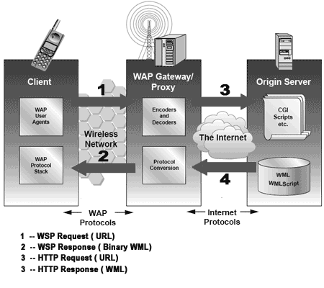
how WAP works?

Slide 4
The user selects an option on their mobile device that has a URL with Wireless Markup language (WML) content assigned to it.
The phone sends the URL request via the phone network to a WAP gateway using the binary encoded WAP protocol.
The gateway translates this WAP request into a conventional HTTP request for the specified URL and sends it on to the Internet.
The appropriate Web server picks up the HTTP request.
The server processes the request just as it would any other request. The Web server adds the HTTP header to the WML content and returns it to the gateway.
The WAP gateway compiles the WML into binary form.
The gateway then sends the WML response back to the phone.
The phone receives the WML via the WAP protocol.
The micro-browser processes the WML and displays the content on the screen.

Slide 5
What is MIME?
Multipurpose Internet Mail Extensions (MIME) is an Internet standard that extends the format of email to support:
Text in character sets other than ASCII
Non-text attachments: audio, video, images, application programs etc.

Slide 6
What are MIME Types?
When a WAP browser receives a document, it needs some way to determine the type of contents the document contains so that it can decide how to deal with the document.
MIME (Multipurpose Internet Mail Extensions) is developed for such purpose.
Web servers choose a suitable MIME type and include it in an HTTP response automatically.

Slide 7
For example, let's say a WAP browser requests a WML file named helloWorld.wml from a WAP server. The WAP server will search for the MIME type associated to the ".wml" extension in the conversion table and includes it in the HTTP response automatically.

Slide 8
Micro Browser
A Micro Browser is a small piece of software that makes minimal demands on hardware, memory and CPU. It can display information written in a restricted mark-up language called WML.

Slide 9
WML
Stands for wireless markup language.
It is a mark-up language inherited from HTML, but WML is based on XML, so it is much stricter than HTML.
WML is used to create pages that can be displayed in a WAP browser. Pages in WML are called DECKS. Decks are constructed as a set of CARDS.

Slide 10
WML Usage:
Text formatting and layout designing :-WML supports text formatting elements like line break, paragraph break, font styles and alignments.
Image Format :-
WML supports wireless Bitmap (WBMP) image format and image alignment on display screen.

Slide 11
User Input :-WML supports Choice List, multiple choice list and text entry.
Organization of card and deck :-
Applications are divided into different cards and with the help of navigation developer can set link between cards. Decks are a set of related cards and composed within a single file.

Slide 12
Create your first card
<wml>
<card title="Home Card" id="home">
<big>Our First Card</big>
<p>Welcome to our first WAP-enabled page. We're using WML1.3 to construct this deck of cards!</p>
<p>Here's a
</card>
</wml>

Slide 13
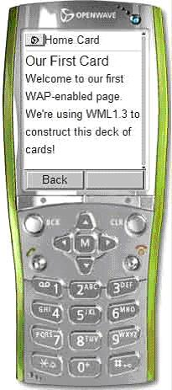
output would look like:

Slide 14
Building decks of cards
WML files can contains multiple cards-these files are known as decks.
Each card in a deck must be uniquely named. Cards are named using the <card > tag’s id attribute and id attribute , and id values may contain text and numbers(but no special characters).
When a deck is loaded the browser processes and stores all the contained cards and then determines which card to display.:
If a specific card id was requested and that id is present , that card is displayed.
If no card id is specified , or the requested id does not exists, the first card in the deck is displayed.

Slide 15
For example:
<wml>
<card id=“1”><p>This is card1 </p><card>
<card id=“2”><p>This is card2 </p><card>
<card id=“3”><p>This is card3 </p><card>
</wml>

